Slide 1
GPS data from monitor
By Monitor
Delegate
Transfer to Web Server
Check In
Normal
GPS data from students
By Teacher
Camera
Quiz
Data is sent back to Teacher’s phone
Processing data

Slide 2
Office – Normal – Web View
Office’s Name
Course Name
Edit Course
Schedule
Check Attendance
Lecturer:
Tas:
Present/Total: 2/10
Total Students: 10
Show attendance history
Show GPS history
Export
Template
Code | Name | Week 1 |  | Week 2 |  | Week 3 |  | Week 4 |  | Week 5 |  | Week ...
145100 | Hoàng An
1451035 | Long Tuấn
1451060 | Triệu Vy
… | …

Slide 3
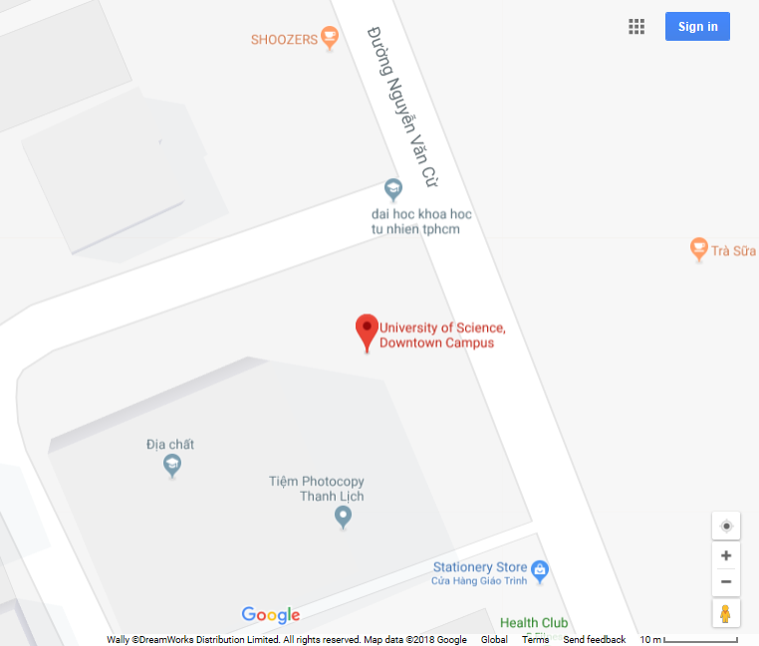

Map View
Read log from Log Server
Checked | Not checked
1, 2, 3, 4, 7, 9 | 5, 6, 8, 9
5, 6
Represent student not checked in in class (change to red)
1,…,4, 7, 9
Represent student checked in in class (change to blue)
8, 9
Close

